Slide 1
Architectural Quality Attributes

Slide 2
What is Quality?
Quality is a degree to which a system satisfies the stated and implied needs of its stakeholders, providing value.
Quality Attributes (QAs) are all good ...but value depends on the project & stakeholder
QAs are not independent: Some qualities can conflict
  Example: A very secure system can be less usable
There is always a price
  What is your budget?
There is no single perfect system or architecture!

Slide 3
Quality attributes
Also known as Architecture characteristics or Non-functional requirements
Requirements:
  Functional
  Non-functional requirements (Quality attributes)
  Constraints: A design decision that has already been made
Functionality has a strange relationship to architecture:
  It does not determine architecture;
  If functionality were the only requirement, the system could exist as a single monolithic module with no internal structure at all
  Functionality and quality attributes are orthogonal
  Quality attributes annotate (qualify) the functionality
  Quality attributes influence the architecture

Slide 4
Quality attribute scenario
QAs by themselves are not enough and these vary widely
They are non-operational
QA scenario: A common form to specify QA requirements
Quality attribute scenarios describe a stimulus of the system and a measurable response to the stimulus
  Stimulus = event triggered by a person or system
  The stimulus generates a response
Must be testable
  Response must be externally visible and measurable

Slide 5
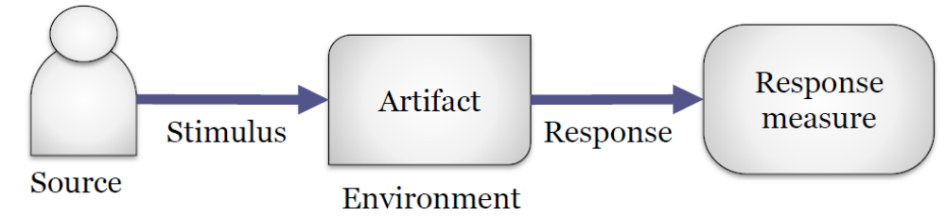
Components of QA scenario
Source: Person or system that initiates the stimulus
Stimulus: Events that requires the system to respond
Artifact: Part of the system or the whole system
Response: Externally visible action
Response measure: Success criteria for the scenario should be specific and measurable
Environment: Operational circumstances should be always defined (even if it is "normal")

Slide 6
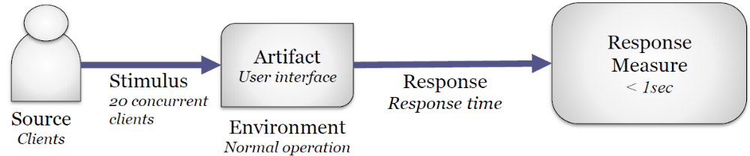
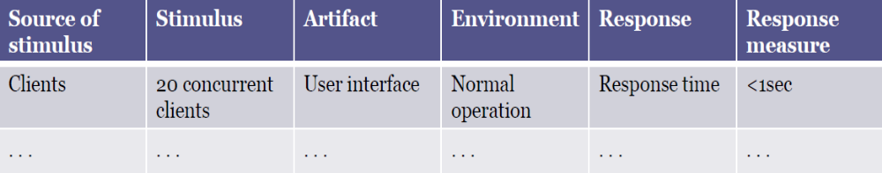
QA scenario, example 1
Performance: If there are 20 concurrent clients, the response time should be less than 1 sec. under normal operation

Slide 7
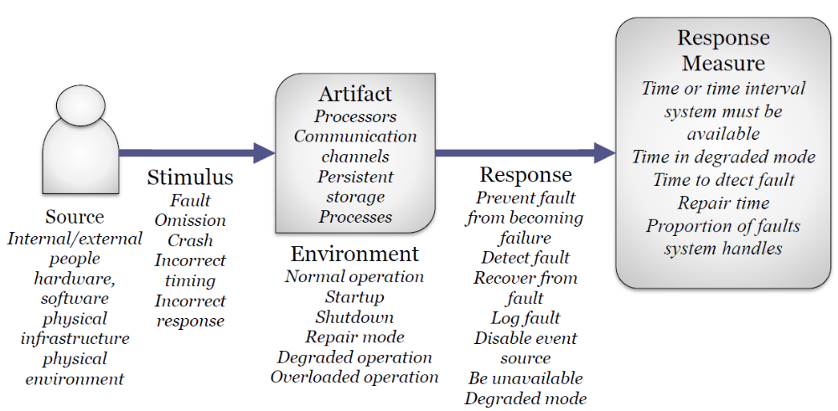
QA Scenario structure for availability

Slide 8
Types of QA scenarios
Usage scenarios
  The system is used (any use case or system function is executed)
  Describe how the system behaves in these cases
  Runtime, performance, memory consumption, throughput,...
Change (or modification) scenarios
  Any component within the system, its environment or its operational infrastructure changes
Failure scenarios:
  Some part of the system, infrastructure or neighbours fail
QA Scenarios should be prioritized (Low/ Medium/ High).

Slide 9
Quality attributes/ Characteristics
Operational Architecture Characteristics
  Operational architecture characteristics heavily overlap with operations and DevOps concerns, forming the intersection of those concerns in many software projects.
Structural Architecture Characteristics
  Architects must concern themselves with code structure. Such cases may be code quality concerns like good modularity, controlled coupling between components, readable code, and a host of other internal quality assessments.
Cross-Cutting Architecture Characteristics
  While many architecture characteristics fall into easily recognizable categories, many fall outside or defy categorization yet form important design constraints and considerations.

Slide 10
Quality attributes/ Characteristics
Operational Architecture Characteristics
Availability: How long the system will need to be available (if 24/7, steps need to be in place to allow the system to be up and running quickly in case of any failure).
Continuity: Disaster recovery capability.
Performance: Includes stress testing, peak analysis, analysis of the frequency of functions used, capacity required, and response times. Performance acceptance sometimes requires an exercise of its own, taking months to complete.
Recoverability: Business continuity requirements (e.g., in case of a disaster, how quickly is the system required to be online again?). This will affect the backup strategy and requirements for duplicated hardware.
Reliability/ safety: Assess if the system needs to be fail-safe, or if it is mission critical in a way that affects lives. If it fails, will it cost the company large sums of money?
Robustness: Ability to handle error and boundary conditions while running if the internet connection goes down or if there’s a power outage or hardware failure.
Scalability: Ability for the system to perform and operate as the number of users or requests increases.

Slide 11
Quality attributes/ Characteristics
Structural Architecture Characteristics
Configurability: Ability for the end users to easily change aspects of the software’s configuration (through usable interfaces).
Extensibility: How important it is to plug new pieces of functionality in.
Installability: Ease of system installation on all necessary platforms.
Leverageability/ reuse: Ability to leverage common components across multiple products.
Localization: Support for multiple languages on entry/query screens in data fields; on reports, multibyte character requirements and units of measure or currencies.
Maintainability: How easy it is to apply changes and enhance the system?
Portability: Does the system need to run on more than one platform? (For example, does the frontend need to run against Oracle as well as SAP DB?
Supportability: What level of technical support is needed by the application? What level of logging and other facilities are required to debug errors in the system?
Upgradeability: Ability to easily/quickly upgrade from a previous version of this application/solution to a newer version on servers and clients.

Slide 12
Identifying quality attributes
Cross-Cutting Architecture Characteristics
Accessibility: Access to all your users, including disable people.
Archivability: Will the data need to be archived or deleted after a period of time?
Authentication: Security requirements to ensure users are who they say they are.
Authorization: Security requirements to ensure users can access only certain functions within the application (by use case, subsystem, webpage, rule, etc.).
Legal: What legislative constraints is the system operating in (data protection, etc.)? What reservation rights does the company require? Any regulations regarding the way the application is to be built or deployed?
Privacy: Ability to hide transactions from internal company employees (encrypted transactions so even DBAs and network architects cannot see them).
Security: Encrypted for network communication between internal systems and/ or database? What type of authentication needs to be in place for remote user access?
Supportability: What level of technical support is needed by the application? What level of logging and other facilities are required to debug errors in the system?
Usability/ achievability: Level of training required for users to achieve their goals with the application/solution. Usability requirements need to be treated as seriously as any other architectural issue.

Slide 13
Identifying quality attributes
Identifying the driving architectural characteristics is one of the first steps in creating an architecture or determining the validity of an existing architecture.
Identifying the correct architectural characteristics (“-ilities”) for a given problem or application requires an architect to understand the domain problem and collaborate with the problem domain stakeholders to determine what is truly important from a domain perspective.
An architect uncovers architecture characteristics in at least three ways:
  Extracting from domain concerns
  Requirements
  Implicit domain knowledge

Slide 14
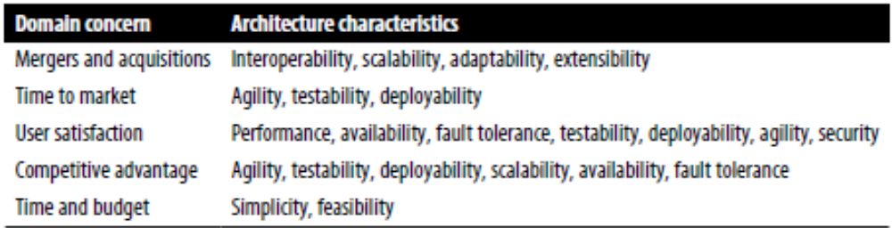
Identifying quality attributes
Extracting Architecture Characteristics from Domain Concerns
An architect must be able to translate domain concerns to identify the right architectural characteristics.
For example, is scalability the most important concern, or is it fault tolerance, security, or performance?
List of characteristics must be as short as possible.
A common anti-pattern in architecture entails trying to design a generic architecture, one that supports all the architecture characteristics.

Slide 15
Identifying quality attributes
Extracting Architecture Characteristics from Requirements
Some architecture characteristics come from explicit statements in requirements documents.
For example, explicit expected numbers of users and scale commonly appear in domain or domain concerns.
Others come from inherent domain knowledge by architects, one of the many reasons that domain knowledge is always beneficial for architects.
For example, scalability- the ability to handle a large number of concurrent users without serious performance degradation.
  Notice that the problem statement didn’t explicitly ask for scalability, but rather expressed that requirement as an expected number of users.

Slide 16
Identifying quality attributes
  Extracting Characteristics from Implicit domain knowledge
Many architecture characteristics aren’t specified in requirements documents, yet they make up an important aspect of the design.
For example;
  availability: making sure users can access the sandwich site.
  reliability: making sure the site stays up during interactions- no one wants to purchase from a site that continues dropping connections, forcing them to log in again.
  Security: appears as an implicit characteristic in every system: no one wants to create insecure software.
  Customizability: Notice that several parts of the problem domain offer custom behavior: recipes, local sales, and directions that may be locally overridden.

Slide 17
Measuring quality attributes
QA scenarios require response measures.
Several common problems exist around the definition of architecture characteristics in organizations:
  Many QA have vague meanings: e.g., deployability, scalability
  Wildly varying definitions: No universal definitions
  Too composite: QA is composed of several features
Software metrics are the measures which can be automatically computed, such as,
  Operational measures
  Structural Measures
  Process measures

Slide 18
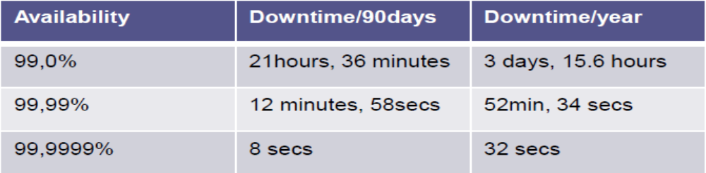
Measuring quality attributes
  Operational measures
Many architecture characteristics have obvious direct measurements, such as performance or scalability.
Lots of metrics
  Absolute values
    e.g, Number of users, number of errors
  Statistical values and models
    e.g., 𝑎𝑣𝑎𝑖𝑙𝑎𝑏𝑖𝑙𝑖𝑡𝑦 = 𝑀𝑇𝐵𝐹 / (𝑀𝑇𝐵𝐹 + 𝑀𝑇𝑇𝑅), where 𝑀𝑇𝐵𝐹 = 𝑚𝑒𝑎𝑛 𝑡𝑖𝑚𝑒 𝑏𝑒𝑡𝑤𝑒𝑒𝑛 𝑓𝑎𝑖𝑙𝑢𝑟𝑒𝑠 (𝑢𝑝𝑡𝑖𝑚𝑒), 𝑀𝑇𝑇𝑅 = 𝑚𝑒𝑎𝑛 𝑡𝑖𝑚𝑒 𝑡𝑜 𝑟𝑒𝑐𝑜𝑣𝑒𝑟 (𝑑𝑜𝑤𝑛𝑡𝑖𝑚𝑒)

Slide 19
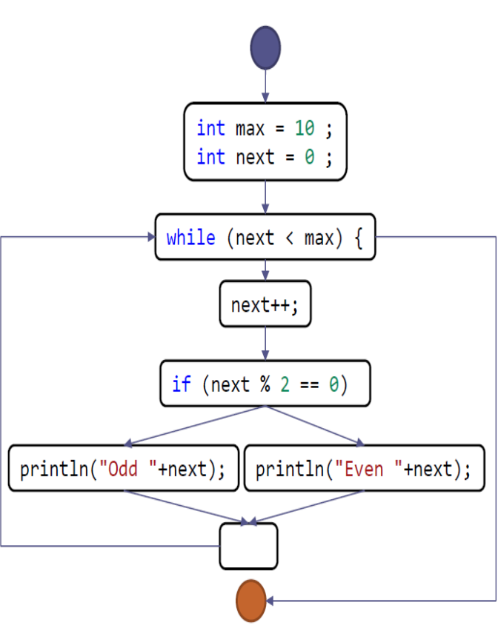
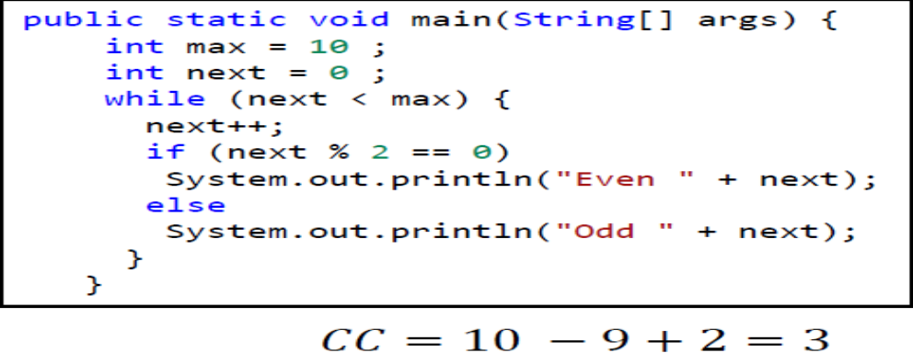
Measuring quality attributes
  Structural Measure
Measure the structure of the modules.
Examples: Cyclomatic complexity (CC) from McCabe (1976) that measures the complexity of code.
It is obtained from program control flow graph 𝐶𝐶 = 𝐸 − 𝑁 + 2, where 𝐸 = n𝑢𝑚𝑏𝑒𝑟 𝑜𝑓 𝑒𝑑𝑔𝑒𝑠, 𝑁 = 𝑛𝑢𝑚𝑏𝑒𝑟 𝑜𝑓 𝑛𝑜𝑑𝑒𝑠.
Example,

Slide 20
Measuring quality attributes
  Process measures
  Measure process aspects like agility, testability, maintainability, deployability etc.
  Examples:
    Testability: Code-coverage during testing
      Percentage of lines of code that have been run during the test phase
    Deployability:
      % of successful to failed deploys
      How long deployment takes
      Issues/bugs in deployment

